Slide 1
Introduction to Data Analytics: Mapping to Marks
Ian Nabney
ian.nabney@bristol.ac.uk

Slide 2
Overview
Reading: Chapter 10 of Munzner
Understand the principles of colour encoding and colour maps
Understand the use of other non-spatial encodings: size, angle, curvature, area, and volume; shape; motion; texture
Able to select appropriate methods for displaying data for a particular task

Slide 3
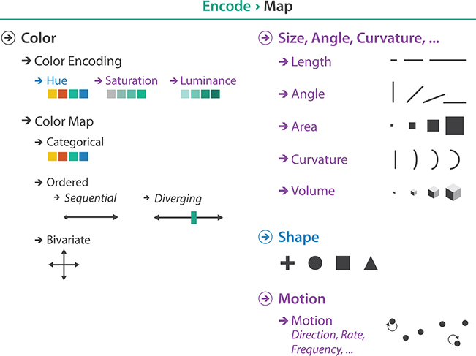
The big picture

Slide 4
Basic colour theory
We will cover this in more depth later (using Ware’s book)
The retina of the eye has two different kinds of receptors.
The rods (the most numerous) actively contribute to vision only in low-light settings and provide low-resolution black and white information. Rods are wasted on modern humans because they
are overloaded at the light levels of our artificially lit world.
The main sensors in normal lighting conditions are the cones.
There are three types of cones, each with peak sensitivities at a different wavelength in the spectrum of visible light.
These three different types of cones mean colour vision is fundamentally three-dimensional.
This is the reason that televisions and monitors have three types of liquid crystal filters.

Slide 5
Colour vision
The visual system immediately processes signals from into three opponent colour channels: red to green, blue to yellow, and black and white encoding luminance information.
The luminance channel conveys high-resolution edge information, while the red–green and blue–yellow channels are lower resolution.
This split between luminance and chromaticity—what most people informally call would normally call colour—is a central issue in visual encoding design.
The theory of opponent colour channels explains what is colloquially called colour blindness, which affects around 8% of men in its most common form.
A “colour-blind” person’s ability to differentiate colour along the red–green channel is reduced or absent but their blue–yellow channel is still in full working order.

Slide 6
Mapping colour spaces
The most common colour space in computer graphics is the system where colours are specified as triples of red, green, and blue value: the RGB system.
Although this system is computationally convenient, it is a very poor match for the psycho-physics of how we see. The red, green, and blue axes of the RGB colour space are not useful as separable channels.
The hue–saturation–lightness or HSL system, is better aligned.
The hue axis captures what we normally think of as pure colours that are not mixed with white or black: red, blue, green, yellow, purple, and so on.
The saturation axis is the amount of white mixed with that pure colour. For instance, pink is a partially desaturated red.
The lightness axis is the amount of black mixed with a colour. It is the brightness of a colour relative to the brightness of a similarly illuminated white.

Slide 7
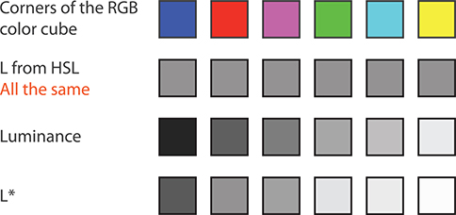
Lightness and luminance
Lightness is very different from our perception of luminance
The computed HSL lightness L is the same for all of these colours
The true luminance values of these same six colours, as could be measured with an instrument.
The computed perceptually linear luminance L* of these colours is the best match with what we see.

Slide 8
Colour and channels
Luminance and saturation are magnitude channels, while hue is an identity channel.
However, all interact with other channels or design elements.
Our perception of luminance has low accuracy for non-contiguous regions because of contrast effects. Thus, the number of discriminable steps is small, typically less then five when the background is not uniform
Luminance contrast is the only way we can resolve fine detail and see crisp edges; hue contrast or saturation contrast does not provide detectable edges. In particular, text is not readable without luminance contrast.
Saturation shares the problem of low accuracy for non-contiguous regions. The number of discriminable steps for saturation is low: around three bins.
Saturation interacts strongly with the size channel: it is more difficult to perceive in small regions than in large ones.
Saturation and hue are not separable channels within small regions for the purpose of categorical colour coding.

Slide 9
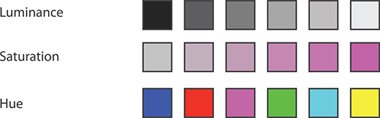
Ordering
Luminance and saturation are automatically perceived as ordered by our perception system, but hue is not
There is a fourth channel, transparency, that interacts strongly with the other three colour channels
It can be used in conjunction with hue encoding with a very small number of discriminable steps, usually two. Transparency is used most often with superimposed layers, to create a foreground layer that is distinguishable from the background layer.

Slide 10
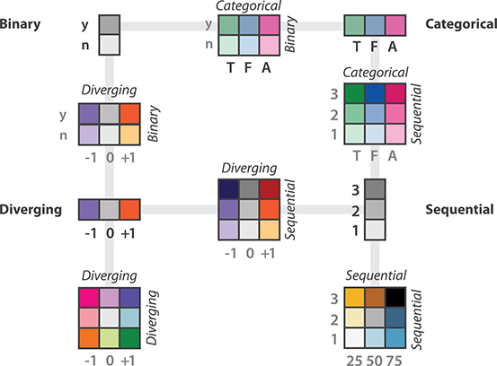
Colo(u)rmaps
The colormap categorization partially mirrors the data types: categorical versus ordered, and sequential and diverging within ordered.
Bivariate encodings of two separate attributes at once is safe if one has only two levels, but they can be difficult to interpret when both attributes have multiple levels.

Slide 11
Categorical colourmaps
The number of discriminable colours for coding small separated regions is limited to between six and twelve bins (including background colour)
Easily nameable colours are desirable. A good set of initial choices are the fully saturated and easily nameable colours, which are also the opponent colour axes: red, blue, green, and yellow.
When more colours are needed try orange, brown, pink, magenta, purple, and cyan.
Colourmap design is a tricky problem: attention must be paid to luminance and saturation.
Luminance contrast is a major issue: for some uses, the colours should be close in luminance to avoid major differences in salience and to ensure that all can be seen against the same background.
Fully saturated yellow and green will have much less luminance contrast against a white background than red and blue.
For other uses, colours should be sufficiently different in luminance that they can be distinguished even in black and white.
Colourmaps for small regions such as lines should be highly saturated, but large regions such as areas should have low saturation. Thus, the appropriate colourmap may depend on the mark type.

Slide 12
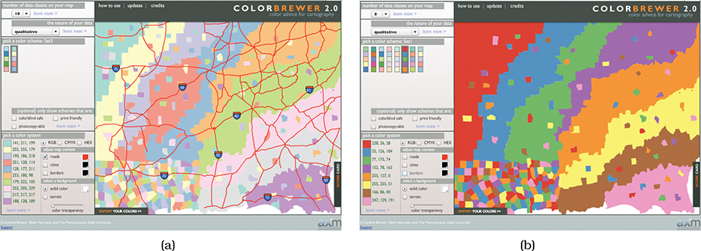
Creating categorial colourmaps
A good resource for creating colourmaps is ColorBrewer at http://www.colorbrewer2.org, a system that incorporates many perceptual guidelines in order to provide safe suggestions.
Saturation and area. (a) The ten-element low-saturation map works well with large areas. (b) The eight-element high-saturation map would be better suited for small regions and works poorly for these large areas.

Slide 13
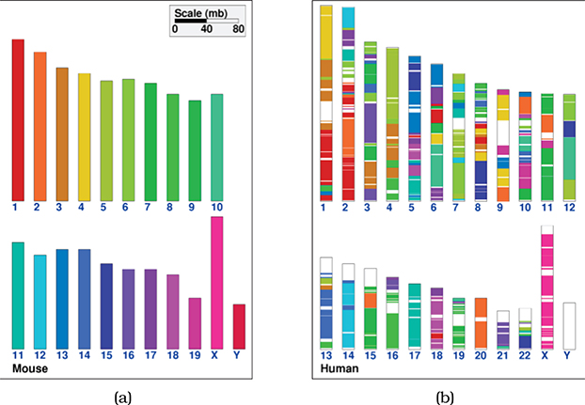
Discriminability issues
While you can tell the colours apart in graph (a) where the regions are large, graph (b) doesn’t work (stacked bar chart labelled by colour) because too many of the colour are indistinguishable at this scale. Two choices to deal with this:
Reduce the number of categories
Use additional channels for encoding (see notes)

Slide 14
Ordered colourmaps
An ordered colourmap is appropriate for encoding ordinal or quantitative attributes
A sequential colourmap ranges from a minimum value to a maximum value. If only the luminance channel is used, the result is a grayscale ramp. When incorporating hue, one end of the ramp is a specific hue at full saturation and brightness. If saturation is the variable, the other end is pale or white; when luminance is the varying quantity, the other end is dark or black.
A diverging colourmap has two hues at the endpoints and a neutral colour as a midpoint, such as white, gray, or black, or a high-luminance colour such as yellow.

Slide 15
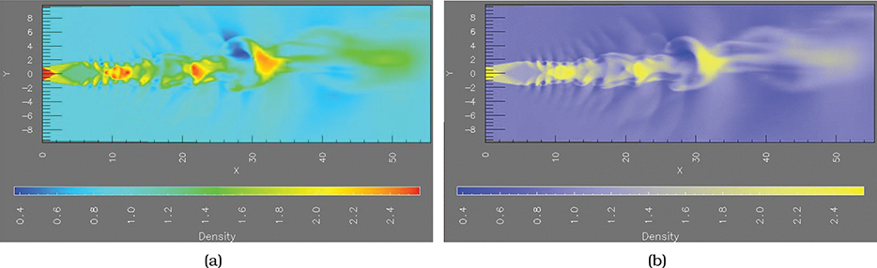
Colourmap hues
The number of unique hues to use in continuous colourmaps depends on what level of structure should be emphasized: the high-level structure, the middle range, or fine-grained detail
The same fluid flow data with two different colourmaps. Figure (a) emphasizes mid-level neighbourhood structure with many hues. Figure (b) emphasizes large-scale structure by ranging between two fully saturated hues, with saturation smoothly varying to a middle point: the ends are purple and yellow, and the midpoint is grey.

Slide 16
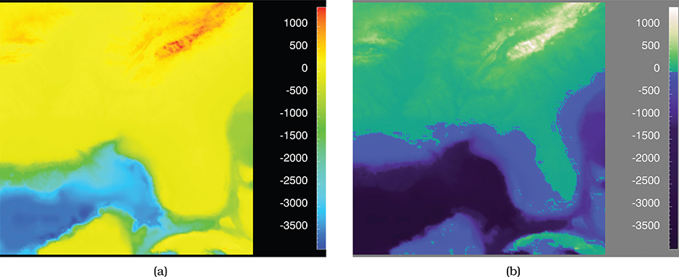
Rainbow colourmap problems
Hue is used to indicate order, despite being without an implicit perceptual ordering
The scale is not perceptually linear: steps of the same size at different points in the colourmap range are not perceived equally by our eyes
Fine detail cannot be perceived with the hue channel
Instead, design monotonically increasing luminance colourmaps

Slide 17
Bivariate colourmaps
The safest use of the colour channel is to visually encode a single attribute; these colourmaps are known as univariate.
Slide 10 includes several colourmaps that encode two separate attributes, called bivariate.
When one of the two attributes is binary then it is straightforward to create a comprehensible bivariate colourmap with two families of colours by fixing a base set of hues and varying their saturation. This approach can also be useful for a single categorical attribute that has a hierarchical structure.
When both attributes are categorical with multiple levels, results will be poor and thus there are no bivariate categorical–categorical maps in on slide 10.
The case of encoding combinations of two sequential or diverging attributes with multiple levels is a middle ground. Slide 10 shows several examples with three levels for each attribute: sequential–sequential, diverging–diverging, diverging–sequential, and categorical–sequential. While these colourmaps do appear frequently in vis systems, some people do have difficulty in interpreting their meaning.

Slide 18
Accessible colourmaps
Colour-blindness is not limited to simply telling red apart from green; many pairs are confused, including red from black, blue from purple, light green from white, and brown from green.
The safest strategy is to avoid using only the hue channel to encode information: design categorical colourmaps that vary in luminance or saturation, in addition to hue. Clearly, avoiding colourmaps that emphasize red–green, especially divergent red–green ramps, would be wise. In some domains there are strong conventions with the use of red and green, so those user expectations can be accommodated by ensuring luminance differences between reds and greens.
An excellent way to ensure that a design uses colours that are distinguishable for most users is to check it with a colour-blindness simulator. This capability is built into many desktop software tools including Adobe Illustrator and Photoshop, and also available through web sites such as http://www.color-blindness.com

Slide 19
Size channels
Size is a magnitude channel suitable for ordered data. It interacts with most other channels: when marks are too small, encodings in another channel such as shape or orientation simply cannot be seen. Size interacts particularly strongly with colour hue and saturation.
The accuracy of our perceptual judgements across length, area and size channels varies considerably.
Our judgements of length are extremely accurate. The only channel that is more accurate is aligned planar position.
Our judgement of area is significantly less accurate. Stevens assigns a power law exponent of 0.7 for area.
The volume channel is quite inaccurate. The volume channel is at the bottom of the rankings, in an equivalence class with curvature. Encoding with volume is rarely the right choice.

Slide 20
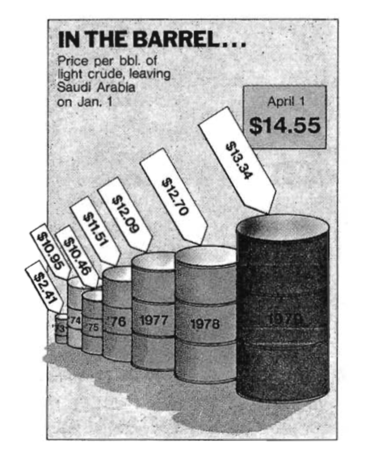
Inaccuracy of volume
In this example from Tufte, the change of 454 percent is depicted as an increase of 4280 percent.
The image comes from Time, April 9, 1979, p. 57.

Slide 21
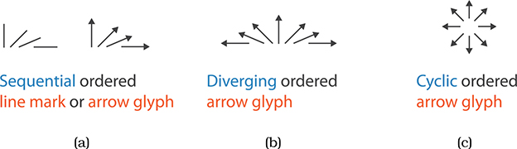
Angle channel
The angle channel encodes magnitude information based on the orientation of a mark: the direction that it points
With angle, the orientation of one line is judged with respect to another line
With tilt, an orientation is judged against the global frame of the display
While this channel is somewhat less accurate than length and position, it is more accurate than area, the next channel down on the effectiveness ranking

Slide 22
Shape channel
The term shape is a catch-all word for a complex perceptual phenomenon. Vision scientists have identified many lower-level features that we can preattentively identify, including closure, curvature, termination, intersection, and others.
Shape can be used with point and line marks. Applying shape to point marks is easy to understand. Applying the shape channel to line marks results in patterns such as dotted and dashed lines.
If the point size is sufficiently large, the number of discriminable bins for the shape channel is dozens or even hundreds. However, there is a strong interaction between shape and size. When the region in which the shape must be drawn is small, then far fewer discriminable bins exist. For example, given a limit of 10 x 10 pixels, with careful design it might be possible to create roughly a dozen distinguishable shapes.
Shape can interfere with other channels in the same way that size coding does, and it can interfere with size coding itself. For example, filled-in shapes like disks are a good substrate for also encoding with colour hue. Line-oriented marks like crosses have fewer pixels available for colour coding, so that channel will be impaired.

Slide 23
Motion channel
Several kinds of motion are also visual channels, including direction of motion, velocity of motion, and flicker frequency.
Motion is less studied than the other visual channels, but some results are known. Motion is extremely salient, and moreover motion is very separable from all other static channels including colour and spatial position.
The strength and weakness of motion is that it strongly draws attention; it is nearly impossible to ignore. The idea behind using separable channels for visual encoding is that the viewer can selectively attend to any of the channels; however, directing attention selectively to the non-moving channels may be difficult when motion is used.
Flicker and blinking are so difficult to ignore that they can be very annoying and should only be used with great care.
Also, since motion is about change in position with time, it necessarily relies on memory to some extent.

Slide 24
Texture
The term texture refers to very small-scale patterns.
It is a complex perceptual phenomenon that can be simplified by considering it as the combination of three perceptual dimensions: orientation, scale, and luminance contrast. The first two pertain to the individual texture elements and have obvious mappings to the angle and size channels, respectively.
Texture can be used to show categorical attributes, in which case the goal is to create patterns that are distinguishable from each other using the combination of all three channels. In this case, with sufficient care it is possible to create at least one or two dozen distinguishable bins.
The term stippling means to fill in regions of drawing with short strokes. It is a special case of texture. Stippling is still in regular use for lines; a familiar example is the use of dotted or dashed lines.
Stippling was heavily used for area marks with older printing technology because it allows shades of grey to be approximated using only black ink; now that colour and grayscale printing are cheap and pervasive, area stippling is less popular than in the past.

Slide 25
Texture example
Texture can be used to visualise flow, depicting vector data, i.e., data with magnitude and direction
Texture-based algorithms take, as input, a vector field and a grey-scale noise texture.
The grey-scale texture is then smeared in the direction of the given vector field.
The time-dependent weather patterns over Europe. http://srnwp.cscs.ch/Gallery/texture loop.html

Slide 26
Summary
Understand the principles of colour encoding and colour maps
Understand the use of other non-spatial encodings: size, angle, curvature, area, and volume; shape; motion; texture
Able to select appropriate methods for displaying data for a particular task

